Slide 1
Statistical Analysis
Topic: Types of Data and their sources
EQ: What are some differences between the two main types of data and their sources?

Slide 2
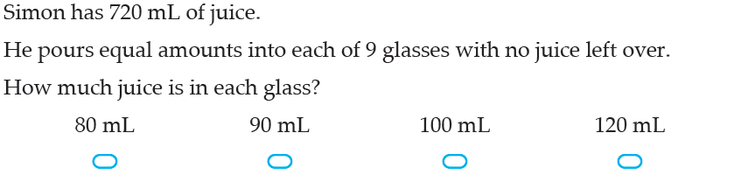
Types of Data and Their Sources EQ: What are some differences between the two main types of data and their sources?
5 Questions
Find the size of the missing angle.
What type of triangle is this?
150ml of cordial was added to 300ml of water. In its simplest form, what is the ratio of cordial to water?
Is the contents page up to date, and have you completed last lesson’s summary?

Slide 3
Types of Data and Their Sources EQ: What are some differences between the two main types of data and their sources?
What is Data?
Data are observations or facts
When collected, organised and evaluated, it becomes information
Data can either be:
Categorical
Numerical

Slide 4
Types of Data and Their Sources EQ: What are some differences between the two main types of data and their sources?
DATA
Categorical
Numerical
This type of data is represented by categories
Example:
Country (Canada, Australia)
Eye Colour (blue, brown)
This type of data is represented by numbers
Example:
Height (2m, 1.4m, 0.9m)
Temperature (23°C)
Number of people in our classroom

Slide 5
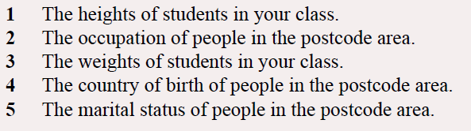

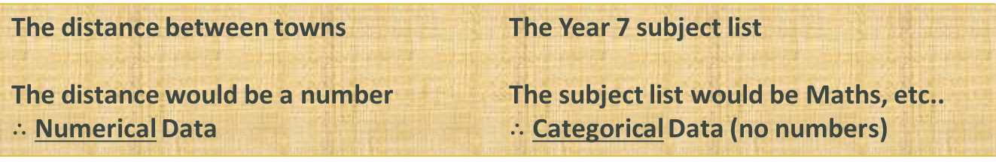
Types of Data and Their Sources EQ: What are some differences between the two main types of data and their sources?
Examples
The distance between towns The distance would be a number $∴$ Numerical Data | The Year 7 subject list The subject list would be Maths, etc.. $∴$ Categorical Data (no numbers)
Your turn:

Slide 6
Types of Data and Their Sources EQ: What are some differences between the two main types of data and their sources?
Furthermore, Numerical can be broken down into two sub-types (both still dealing with numbers):
DATA
Numerical
Discrete
Continuous
This type of data is counted
Example:
TVs in the house
Number of people
This type of data is measured
Example:
Weight
Time to run 100m

Slide 7
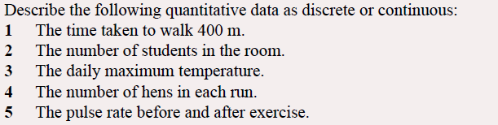
Types of Data and Their Sources EQ: What are some differences between the two main types of data and their sources?
Examples
numerical

Slide 8
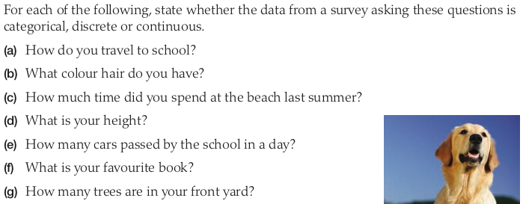
Combined Practice – LHS of INB
Categorical
Categorical
Continuous
Continuous
Discrete
Categorical
Discrete

Slide 9
Types of Data and Their Sources EQ: What are some differences between the two main types of data and their sources?
Primary data:
Primary data is first hand information collected directly from the source. The investigator himself collects primary data or supervises its collection. It may be collected on a sample, census basis or case studies.
eg you conduct a survey or experiment and get raw data
Secondary data:
Secondary data is data which has already been collected and processed by others. Secondary data is already in existence and which have been collected for some other purpose.
eg you find a newspaper article or website with useful statistics

Slide 10
LHS – Primary vs Secondary data
Answer if you believe these to be Primary or Secondary sources of data
You read about the results from the census
You collect opinions from you friends on movies.
You conduct a survey of you class
Visit a food rating site to get an average rating for a café
Conduct a quick poll of friends and family on the best place to eat
You hear a politician talking about the results of their survey

Slide 11
Homework
Review Notes
Primary and Secondary sources worksheet

